Slide 1
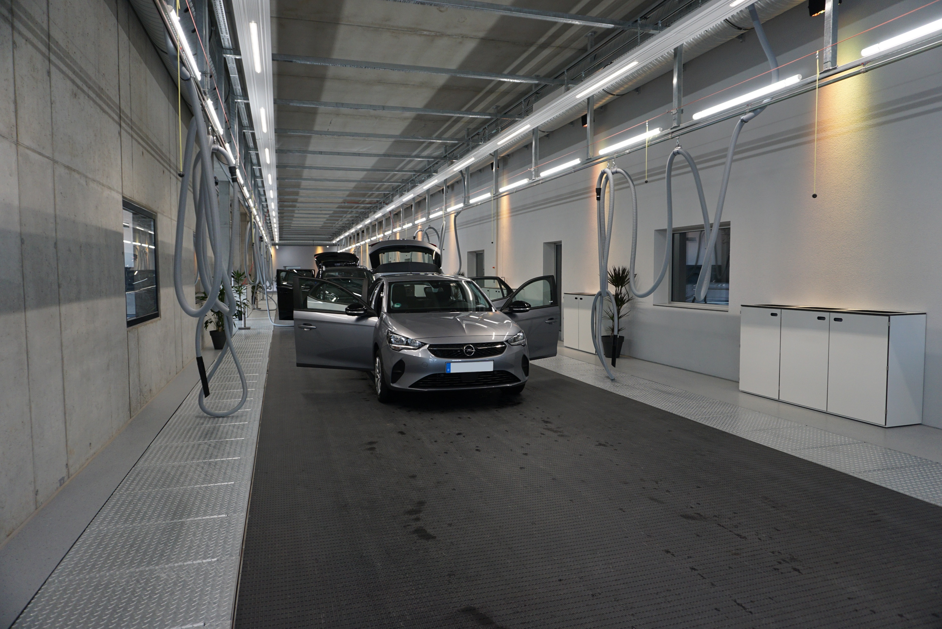
Car Parking Technology Using a Conveyor Belt Grid
BY NAVEEN RAMKUMAR

Slide 2
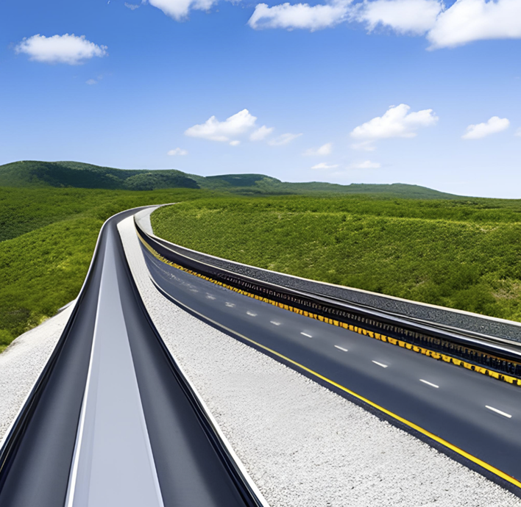
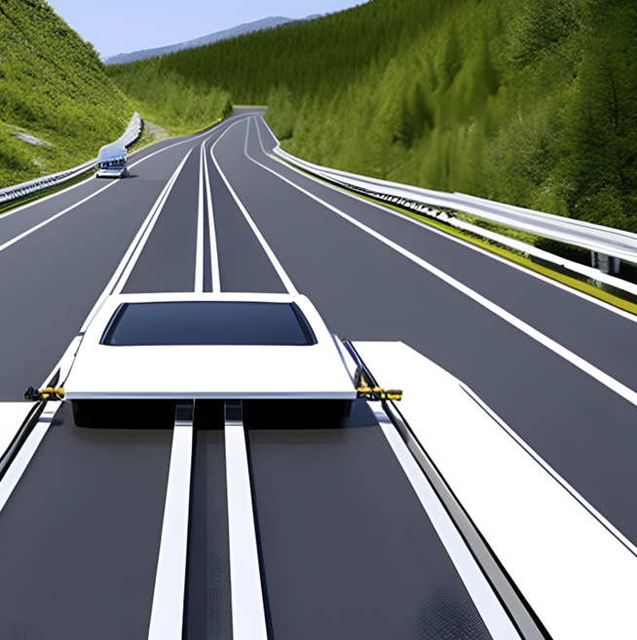
Problem Statement
Lack of Car Parking Space in Cities
Car parking is a frustrating and annoying problem faced by all of us today with the increase in population and with one person owning more than one car.
There is an unequal distribution of space in cities with some places having an excess of unused space and others extremely congested, which creates a dearth of available car parking space.

Slide 3
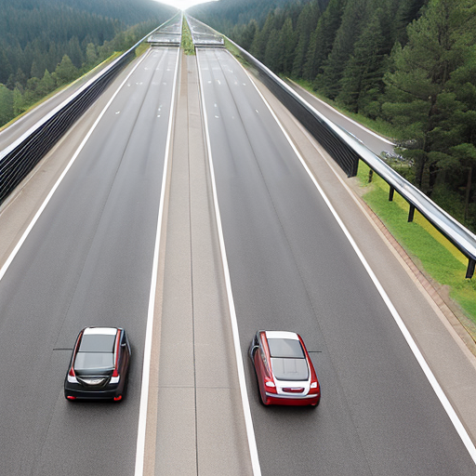
Solution
Create a conveyor belt grid spanning the entire city parallel to the wide (3 lanes and above) roads.
As of 2020, there are a total 320 km of 4 lane roads and 186 km of 3 lane roads in Bengaluru. Length of average car = 5m.
Number of cars that can be parked on a single lane conveyor belt spanning the full length of these roads = [(186+320)*1000]/5 = 1,01,200 Cars
Practically, we cannot park so many cars in parallel parking because of a lot of unused space and unequal distribution of land.
With this technology, any unused space in any part of the city can be utilized to park cars in any other part of the city.

Slide 4
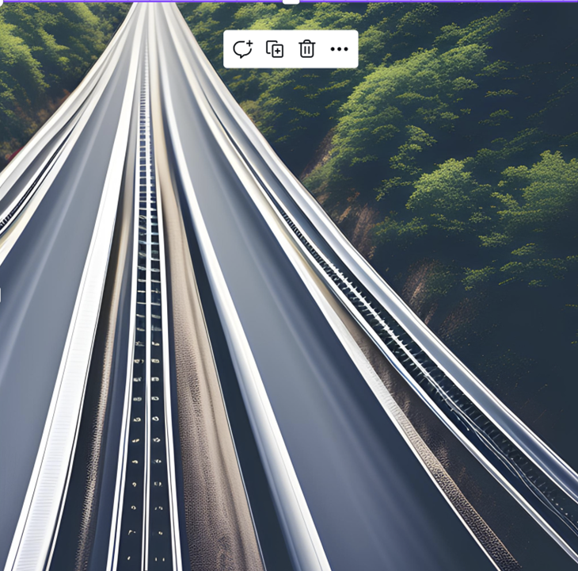
Techstack
Construct a one lane wide conveyor belt parallel to the major wide roads.
Two orthogonal belts can be joined by a rotating disc platform so that a car moving in one belt can be shifted to the other.
Install force/pressure sensors each with their own signal path on the belt that sense the location of a car loaded onto it. Also install request buttons periodically on a railing adjacent to the belt and a small digital kiosk corresponding to every request button.
Create a database that stores the name of the car owner, the sensor associated with its wheels and its location on the belt.
Can use Magnetic Levitation / Regular Motor technology to move the belt faster and for greater efficiency.
Arduino boards can be used to program the sensors.

Slide 5
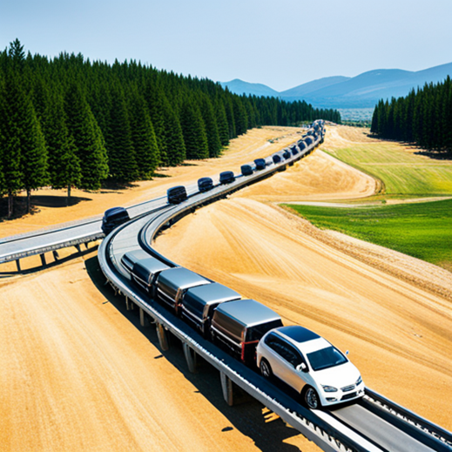
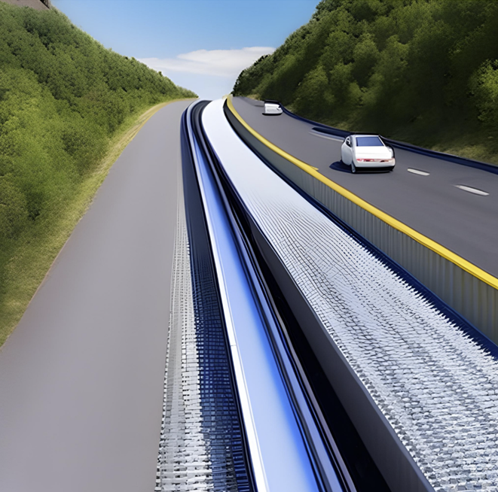
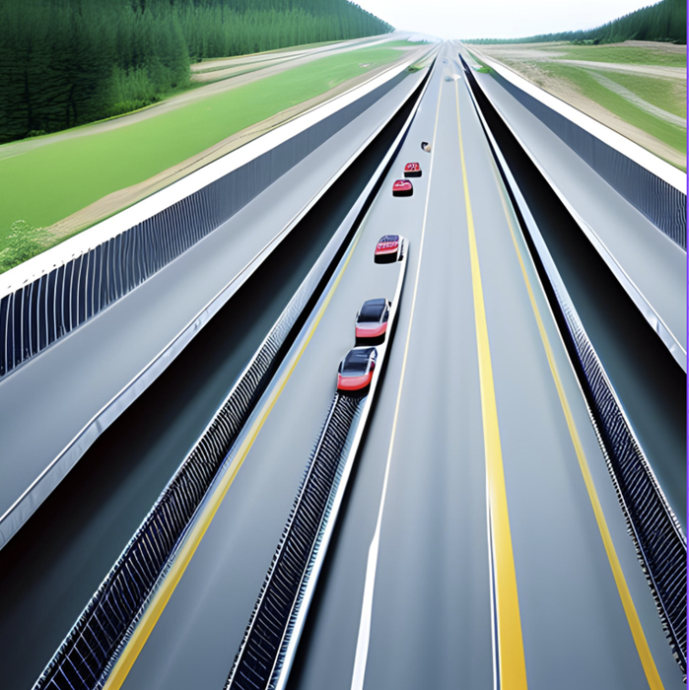
The belts can be installed in the sides of the road, in the middle of the road or in unused deserted lands.

Slide 6
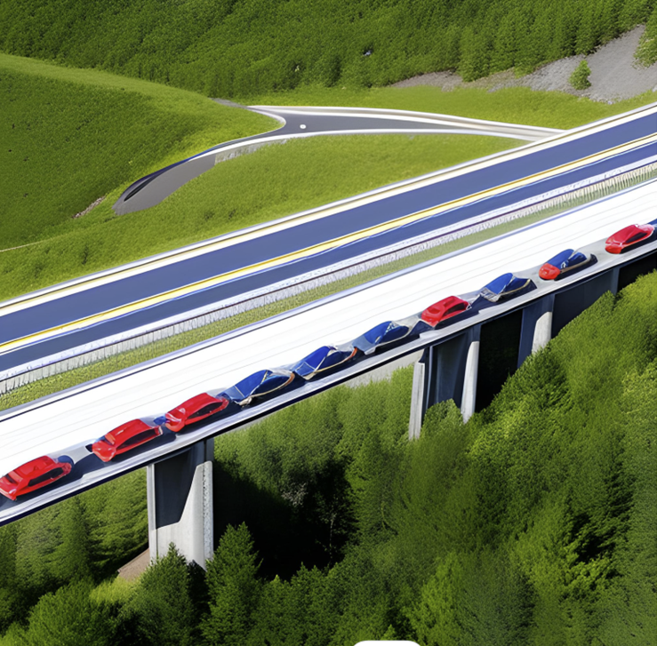
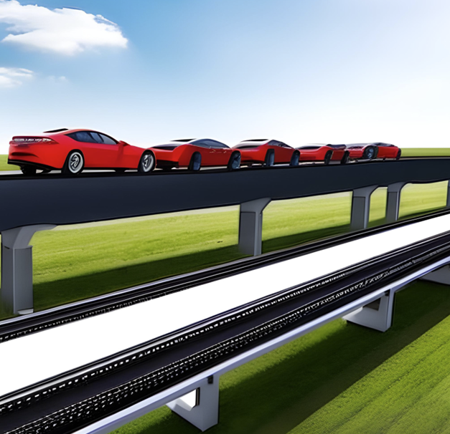
If space is not available in the ground level, the conveyor belt can be constructed overground in an elevated form similar to the Metro trains.

Slide 7
Architecture / Implementation
When a car owner wants to park a car, he/she must press the request button in the area he is accessing the belt.
The conveyor belt searches for the closest empty spot on it and brings it to the user.
The owner has to enter his details along with the car model and park the car on the conveyor belt.
The belt registers the location of the car using the pressure sensors and associates it with a unique ID generated by the software, which is given to the user.
The Car along with its associated user ID is entered into a database containing the details of all the cars parked on the belt.
When the user wants to retrieve the car back, he/she has to enter the unique ID in the kiosk, which is used by the database to search the location of the car and bring it back to the user.
When multiple requests are entered, the database prioritizes them using a Queue stack.

Slide 8
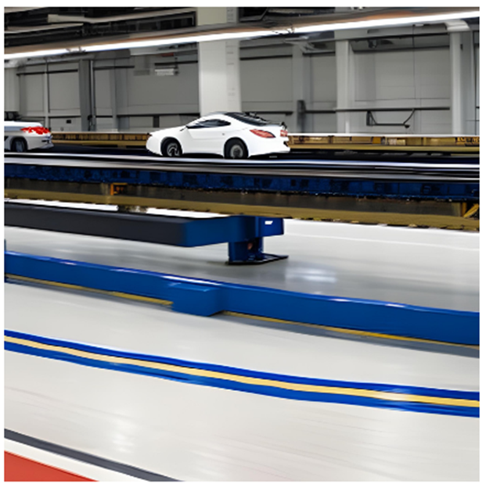
How the idea is unique
Unlike Underground / Multilevel car parking, this requires only one lane width of space but makes use of the length of the belt across the cities. The space is distributed across an entire city and is not concentrated in one place so that all can access and use the facility.
A car owner can use any vacant space available anywhere in the city where the conveyor belt is built. Therefore, more space is created due to the equal utilization of all space in the city.

